Slide 1
BBO evaluation update

Slide 2
What have we done so far?
Stakeholder research
Recently-ended projects
Participant research
“Baseline” participant survey
Launched follow up participant survey
Outputs
Participant case study paper
Annual report
Data analysis
Research tools for case studies
Depth interviews with participants
Programme MI data
Partnership data
Survey data
Learning events x3
Ad-hoc interviews with projects
Steering group meeting

Slide 3
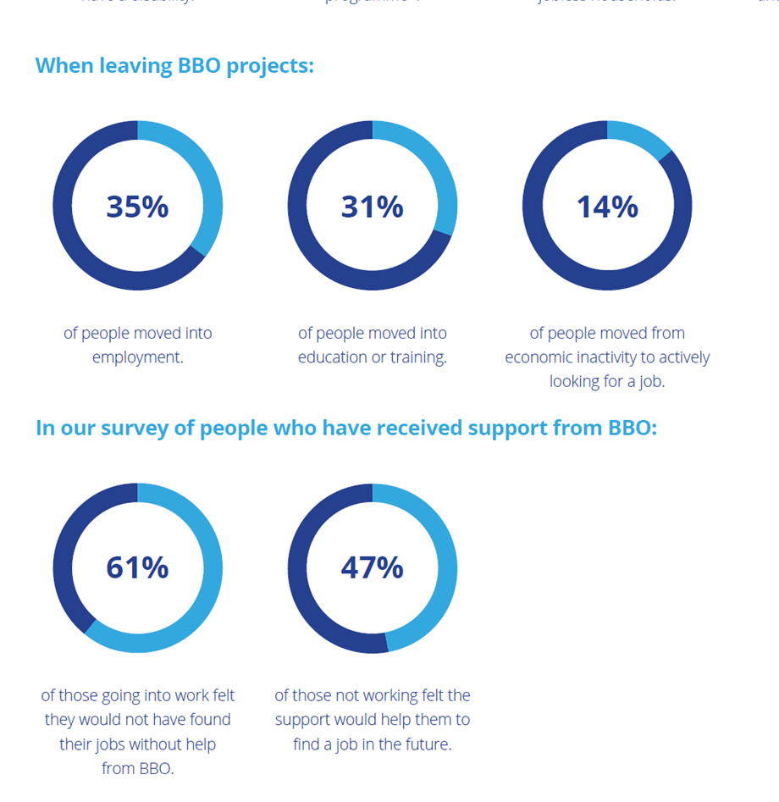
Annual report
Great news!
But… What happened to the 36% who didn’t register a result or destination?

Slide 4
Participant survey
Designed to explore destinations and sustainability
Interviews at two points in time: follow up after six months
Target of 400 participants interviewed at baseline and 150 at follow up
First wave of interviews conducted in February 2021, with participants who left in August / September 2020. Now on to our third wave
Follow up survey launched last month, reinterviewing those we spoke to in February
Results will feed into next annual report – winter 21 / spring 22

Slide 5
Participant survey – early findings
Early survey results suggest jobs are being sustained
67% working more than 15 hours
17% in zero hours contracts
Participants experienced
  Improved confidence
  Improved wellbeing
  Improved financial situation
  Improved skills

Slide 6
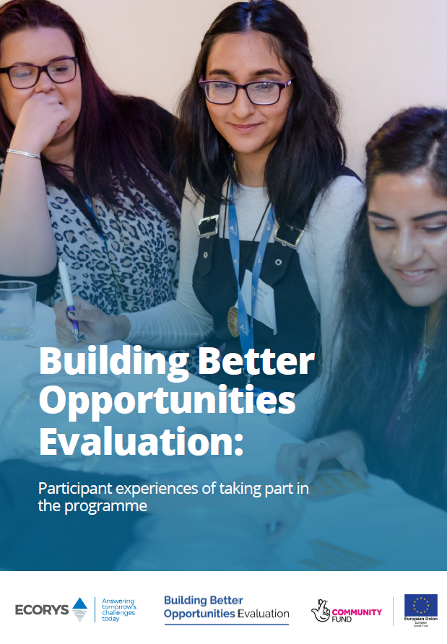
Participant case study paper
Four case studies:
Based on depth interviews with survey participants (opted in to follow up)
Sampled on basis of interesting stories emerging from survey findings
“I was out of work for seven months… now I have a job that I enjoy so much. I can pay my bills now and I am off benefits, which is what I wanted.”
“I’m working as an IT tutor. I feel more independent in myself, and I am enjoying the work that I do.. I don't think I would have found this position without the help from the mentor on my course.”

Slide 7
Shifting the evaluation focus
Ongoing impact of the pandemic on engagement and results
Destinations
Sustainability of results
Quality of jobs as the economy recovers / changes
How are different groups or demographics faring in these categories?
How BBO is positioned in the wider sector? How can it contribute to future programme development?

Slide 8
What’s coming next?
Stakeholder research
Case study visits – but first, sampling
Participant research
Continue follow-up survey
Outputs
Dissemination of existing outputs
Data analysis
Project evaluations
Learning event
Third wave of baseline survey
Ongoing MI and survey analysis

Slide 9
Case study visits
Good practice and innovative approaches to supporting:
Young people
Women
BAME and refugees
Older people
Health and disability
Rural locations
Does your project fit this bill?

